Slide 1



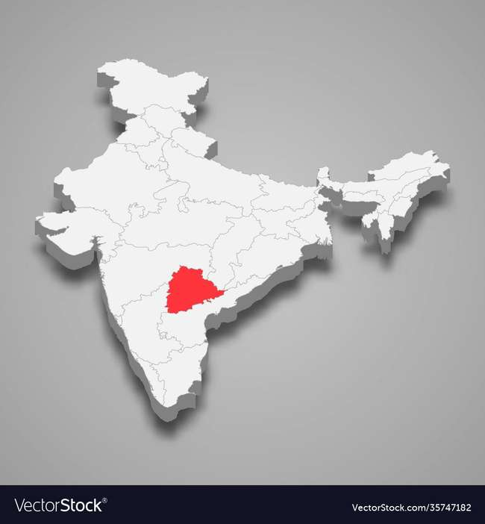

RESUME PROJECT
Analyse Growth and Present Insights to the Telangana Government
-V.Soundarya Lakshmi

Slide 2

Overview
The Telangana government and Codebasics have collaborated to offer a special opportunity called Resume Project to all the data enthusiasts out there.
They have provided real time data sets and a chance to present our insights to top level management.
We can use any tool of our choice (Python, SQL, PowerBI, Tableau, Excel, PowerPoint) to analyze and answer their questions.

Slide 3


ANALYSIS
Revenue generated from document and e-stamp registration
Vehicle sales
Investment in various sectors
Growth of Real estate
Government policies
RESOURCES
Stamp Registration data
Transportation data
Industrial projects data
Real estate websites
Additional data from Open data Telangana website
OBJECTIVES
RESULTS
The insights derived from the data analysis will be used for the growth of Telangana state.

Slide 4






Categories
Revenue
Transportation
Industry
Secondary Research

Slide 5

Revenue
The Fact stamps dataset provides data on the revenue generated from document registrations and e-stamp challan payments aggregated at the district and monthly level from the fiscal year 2019 to 2022.
Electronic Stamp (e-stamp) is a digital alternative to traditional stamp papers introduced from December 2020.

Slide 6
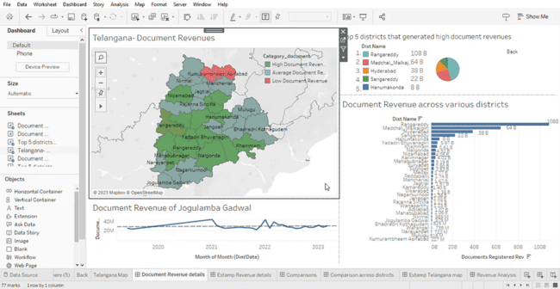
Document Revenue Dashboard

Slide 7
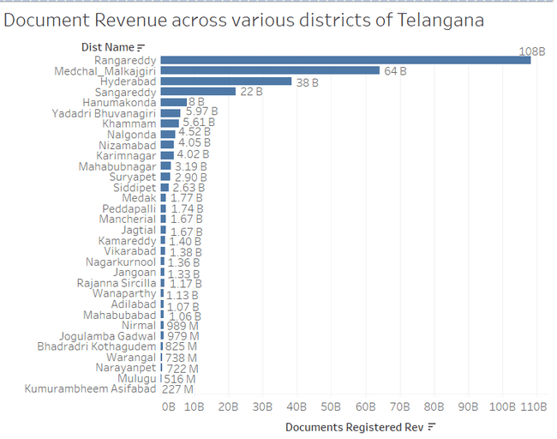
1. How does the revenue generated from document registration vary across districts in Telangana?

Slide 8
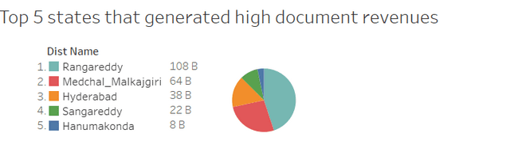
2. List down the top 5 districts that showed the highest document registration revenue growth between FY 2019 and 2022.

Slide 9
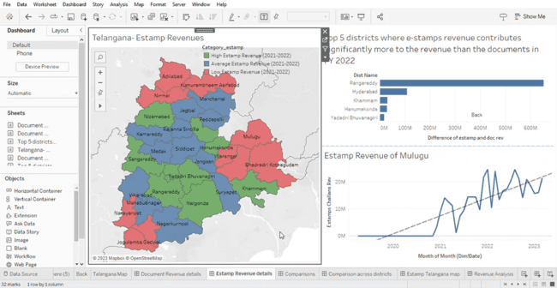
E-stamp Revenue Dashboard

Slide 10
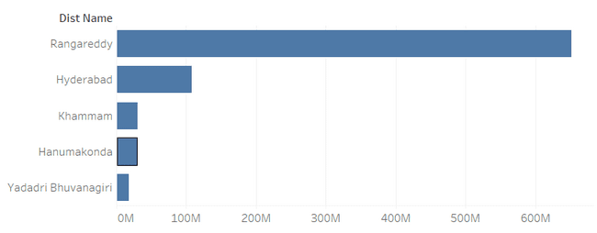
3. List down the top 5 districts where e-stamps revenue contributes significantly more to the revenue than the documents in FY 2022?

Slide 11
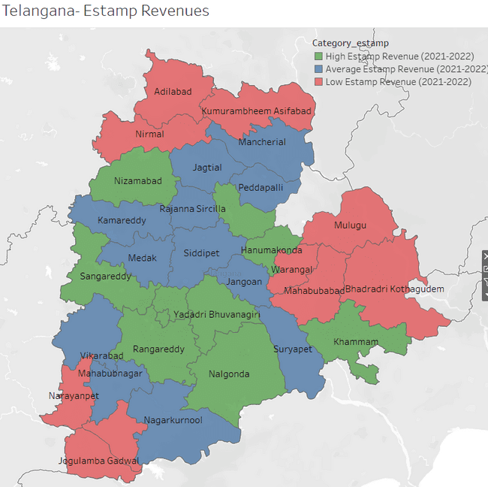
4. Categorize districts into three segments based on their stamp registration revenue generation during the fiscal year 2021 to 2022.
High e-stamp revenue:
Hanumakonda
Hyderabad
Karimnagar
Khammam
Medchal Malkajgiri
Nalgonda
Nizamabad
Rangareddy
Sangareddy
Yadadri Bhuvanagiri
Average e-stamp revenue:
Jagtial
Jangoan
Kamareddy
Macherial
Mahabubnagar
Medak
Nagarkurnool
Pedapalli
Rajanna Sircilla
Siddipet
Suryapet
Vikarabad
Low e-stamp revenue:
Adilabad
Bhadradri Kothagudem
Jogulamba Gadwal
Kumurambheem Asifabad
Mahabubabad
Mulugu
Narayanpet
Nirmal
Wanarpathy
Warangal

Slide 12
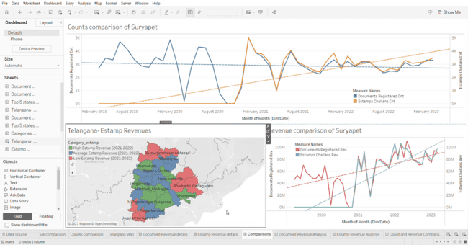
Comparison of Revenue and Challan Count Across Districts

Slide 13
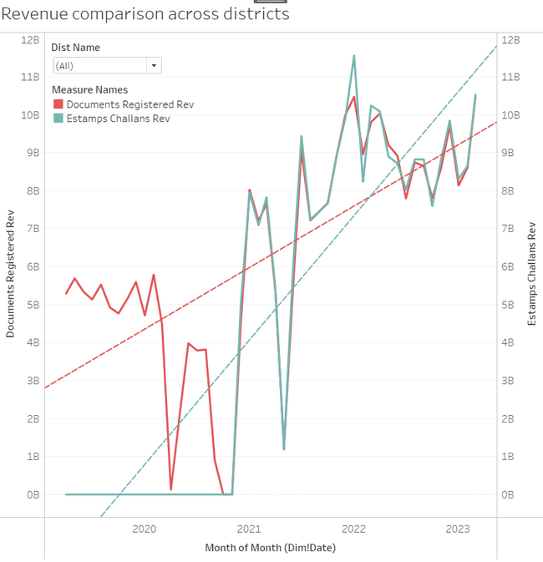
5. How does the revenue generated from document registration compare to the revenue generated from e-stamp challans across districts?
After e-stamp registration was introduced, this procedure overlaps with the document registration.
Starting from year 2022, e-stamp registration is slightly greater than the document registration.

Slide 14
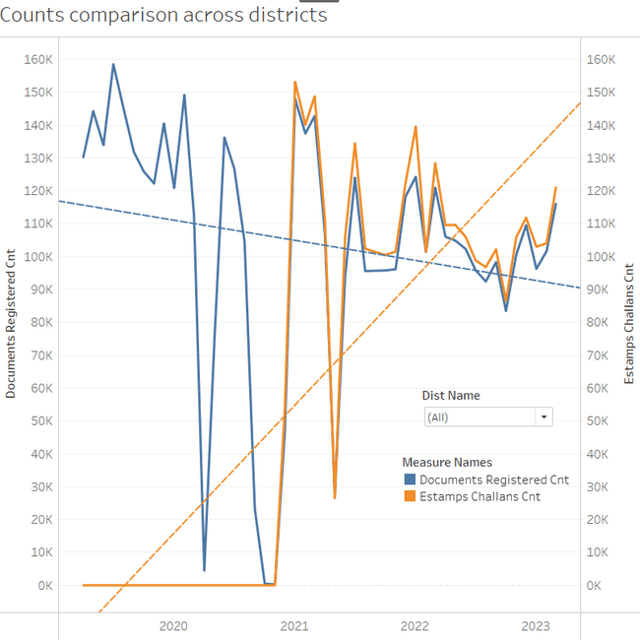
6. Is there any alteration of e-Stamp challan count and document registration count pattern since the implementation of e-Stamp challan? If so, what suggestions would you propose to the government?
Document count has reduced since the introduction of e-stamp challan.
This shows that people are more interested in e-stamp challan.

Slide 15
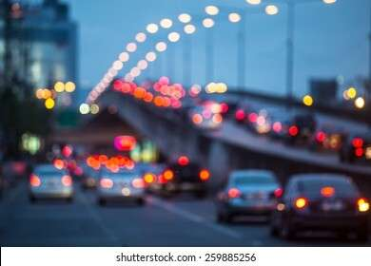
Transportation
Fact transport dataset provides information about the individual vehicle sales data from the RTA(Regional Transport Authority) of the state of Telangana categorized by fuel type, vehicle class, seating capacity, and other general categories aggregated at the district and monthly level.

Slide 16
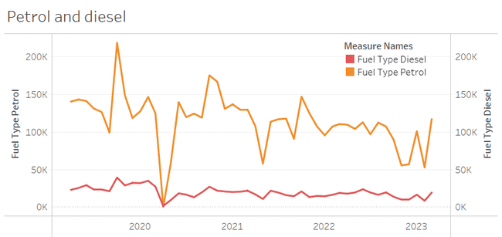
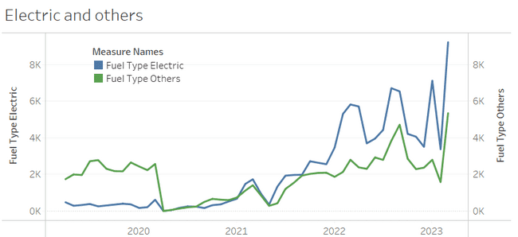
1. Investigate whether there is any correlation between vehicle sales and specific months or seasons in different districts. Are there any months or seasons that consistently show higher or lower sales rate, and if yes, what could be the driving factors? (Consider Fuel-Type category only)

Slide 17
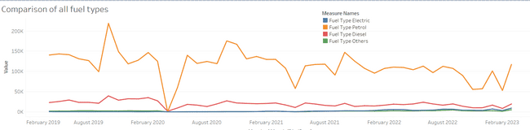
Sales Comparison of All Fuel Type Vehicles

Slide 18
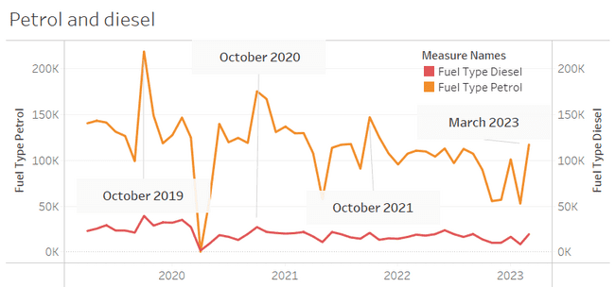
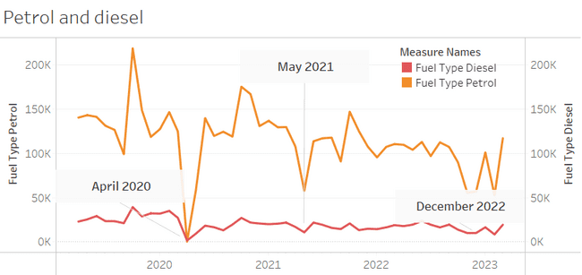
Sales of Petrol and Diesel Type Vehicles
The sales of petrol and diesel type vehicles are at peak during October.
This could be due to discounts offered during festive season.
The sales are also high at march because business people buy vehicles during march for tax benefits.
The sales of petrol and diesel type vehicles are low during the holidays.

Slide 19
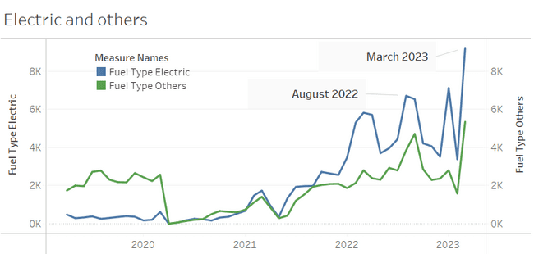
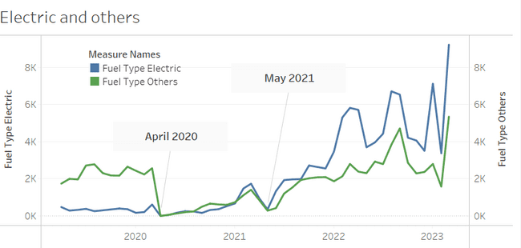
Sales of Electric and Other Fuel Type Vehicles
The sales of electric and other fuel type vehicles are high during August and March.
The sales are high at march because business people buy vehicles during march for tax benefits.
The sales of electric and other fuel type vehicles are low during the holidays.

Slide 20
2. How does the distribution of vehicles vary by vehicle class (MotorCycle, MotorCar, AutoRickshaw, Agriculture) across different districts? Are there any districts with a predominant preference for a specific vehicle class? Consider FY 2022 for analysis.
All districts prefer Motor Cycle.
Jayashankar Bhupalpally and Jangoan prefer agriculture vehicles as the second most.
All the remaining districts prefer Motor car as the second most.

Slide 21
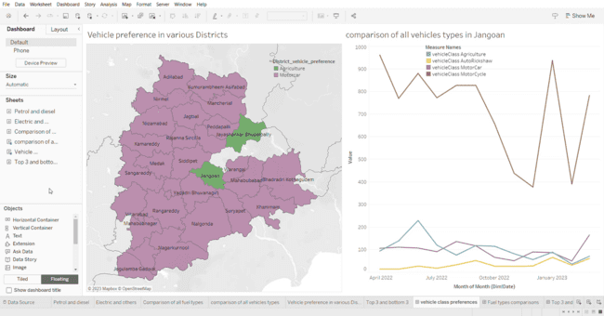
Vehicle Preference in Various Districts

Slide 22
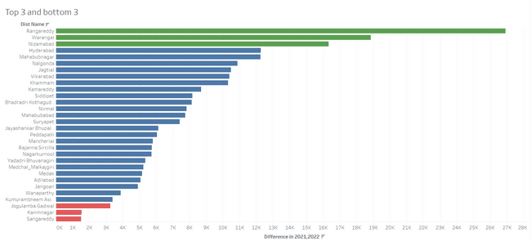
3. List down the top 3 and bottom 3 districts that have shown the highest and lowest vehicle sales growth during FY 2022 compared to FY 2021? (Consider and compare categories: Petrol, Diesel and Electric)

Slide 23
The TS-iPASS dataset in Telangana comprises data concerning units or businesses established within the state under the "Industrial Project Approval and Self-Certification System" (iPASS).
This government initiative aims to foster industrial growth and investment by streamlining project approvals and enabling self-certification for businesses.
This dataset has the investment and employment information of the following 20 sectors.
Industry
Agro based incl cold storages
Automobile
Beverages
Cement, Cement & Concrete products, Fly Ash products
Electrical and Electronic products
Engineering
Fertilizers organic and inorganic, Pesticides, Insecticides and other related
Food processing
Granite and stone crushing
Industrial Parks and IT Buildings
11. Others
12. Paper and Printing
13. Pharmaceuticals and Chemicals
14. Plastic and Rubber
15. R & D
16. Real Estate, Industrial parks and IT Buildings
17. Solar and other renewable energy
18. Textiles
19. Thermal Power Plant
20. Wood and Leather

Slide 24
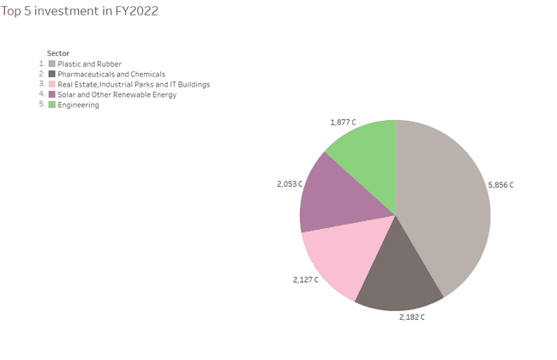
1. List down the top 5 sectors that have witnessed the most significant investments in FY 2022.

Slide 25
2. List down the top 3 districts that have attracted the most significant sector investments during FY 2019 to 2022? What factors could have led to the substantial investments in these particular districts?
1. Rangareddy:
The district includes several important industrial and IT hubs, making it a significant contributor to the state’s economy.
2. Sangareddy:
The district has several historical sites and monuments that attract tourist and history enthusiasts.
3. Medchal Malkajgiri:
The district is known for its rapid urbanization and growth, with many residential and commercial developments.

Slide 26
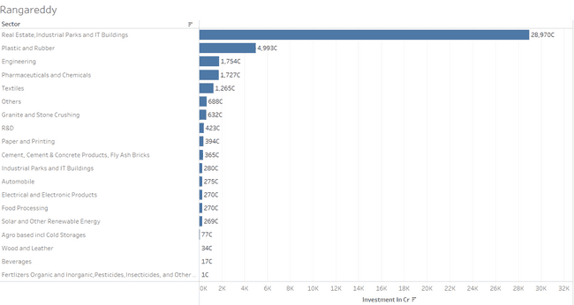

Slide 27
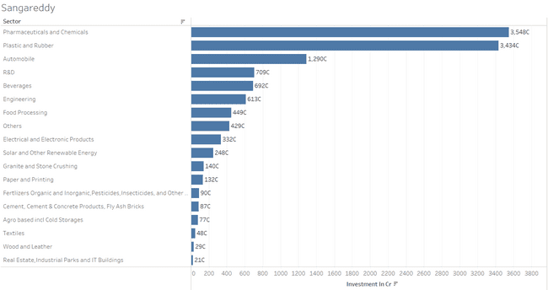

Slide 28
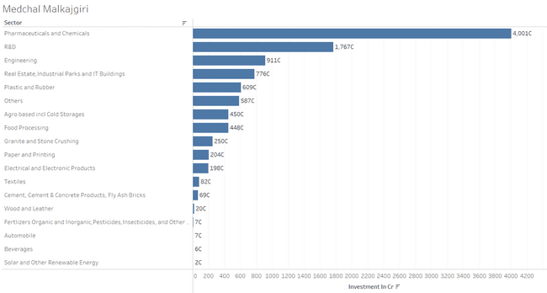

Slide 29
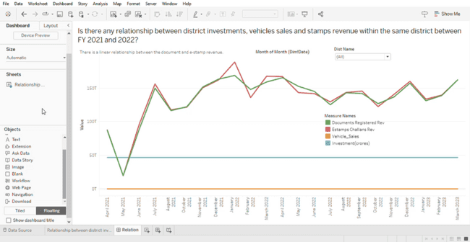
3. Is there any relationship between district investments, vehicles sales and stamps revenue within the same district between FY 2021 and 2022?

Slide 30
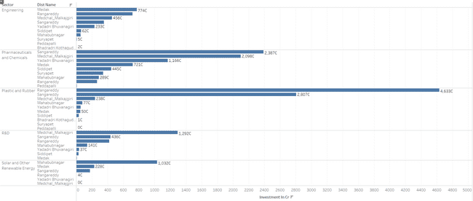
4. Are there any particular sectors that have shown substantial investment in multiple districts between FY 2021 and 2022?

Slide 31
5. Can we identify any seasonal patterns or cyclicality in the investment trends for specific sectors? Do certain sectors experience higher investments during particular months?
A quarterly analysis of the investment trend shows some cyclic patterns during certain period.
Q1- April to June
Q2-July to September
Q3-October to December
Q4-January to March

Slide 32
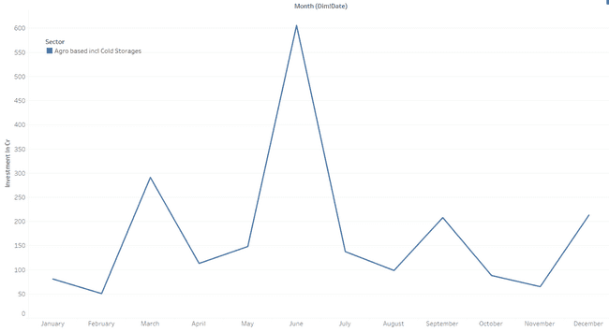
Q1- April to June

Slide 33
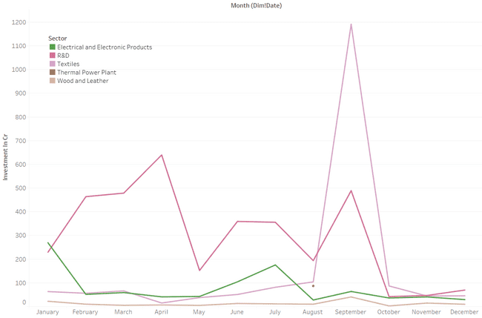
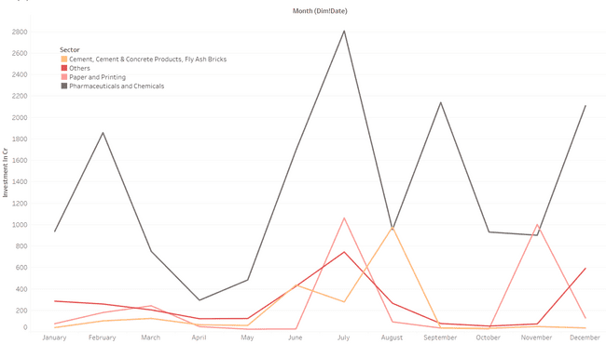
Q2-July to September

Slide 34
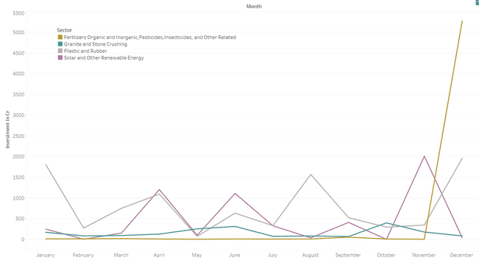
Q3-October to December

Slide 35
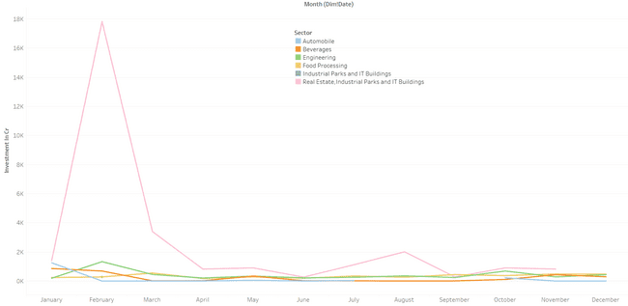
Q4-January to March

Slide 36
Secondary Research
Commercial property information
Initiatives by the Government
Overall Analysis and Recommendations for Telangana

Slide 37
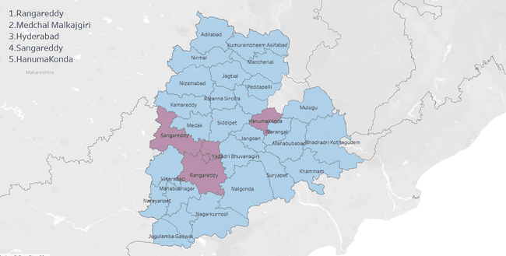
1. What are the top 5 districts to buy commercial properties in Telangana? Justify your answer.

Slide 38
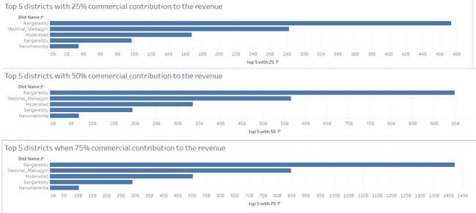
Assumed Contributions

Slide 39
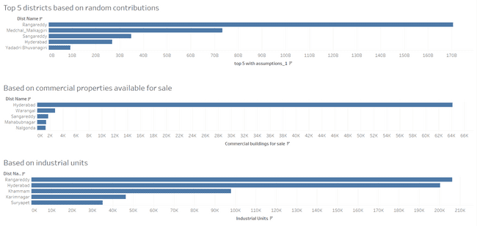
Other Contributions
Dataset for industrial units: https://data.telangana.gov.in/dataset/overview-industries-and-investment

Slide 41
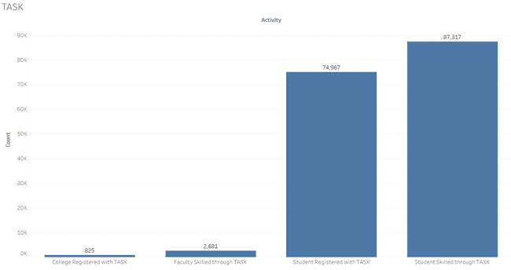
2. What significant policies or initiatives were put into effect to enhance economic growth, investments, and employment in Telangana by the current government? Can we quantify the impact of these policies using available data?
Telangana Academy for Skill and Knowledge(TASK):
The Institute for Electronic Governance (IEG) of the Department of IT&E, Government of Telangana, has launched the TASK project to foster communication between business, academia, and the state.
Dataset used: https://data.telangana.gov.in/dataset/skill-development-under-telangana-academy-skill-knowledge-task

Slide 42
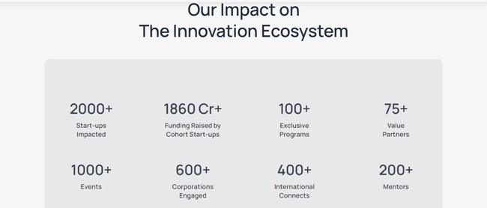
T-Hub:
The government established T-Hub, a startup incubator and accelerator, to foster innovation and entrepreneurship in the state. It provided support to startups and helped create a thriving ecosystem for technology and innovation.

Slide 43
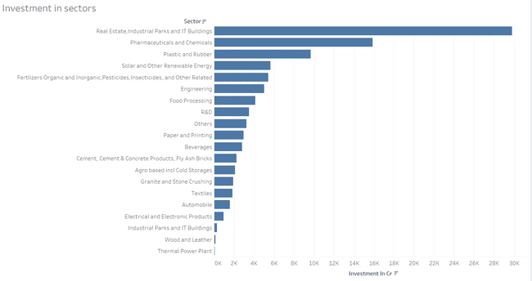
Information Technology (IT) Sector:
The government encouraged the growth of IT companies and IT parks, including initiatives to attract investments from major technological companies.
From the existing data, it is the highest investment sector.

Slide 44
3. Provide top 5 Insights & 5 recommendations to Telangana government for sustained growth in the next 5 years based on your analysis
1. Economic growth:
Increase in revenue generated from document registration and e-stamp registration.

Slide 45
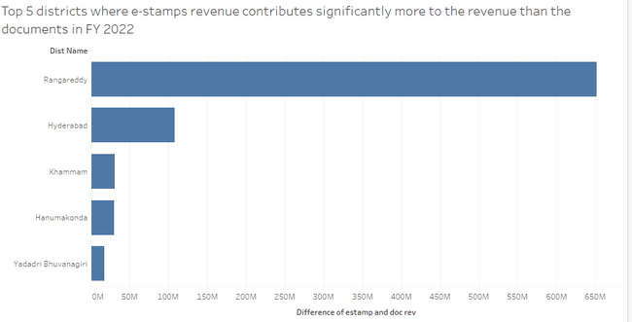
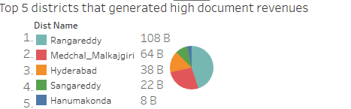
2. Rangareddy- the richest district
Has highest document revenue, estamp revenue, vehicle sales growth and sector investment
Vehicle Sales
District with multiple investment sectors

Slide 46
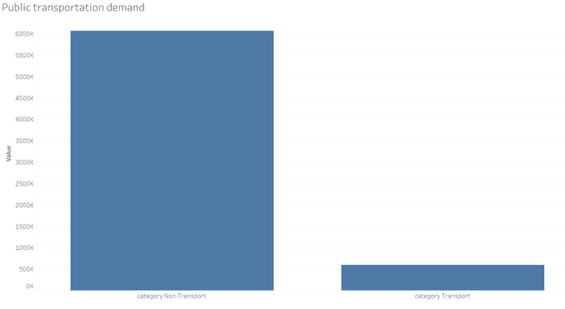
3. Public Transportation Demand is Less Compared to Private Transportation

Slide 47
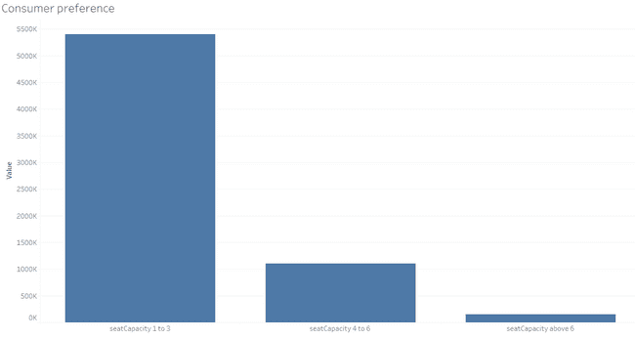
4. Consumer Preference

Slide 48
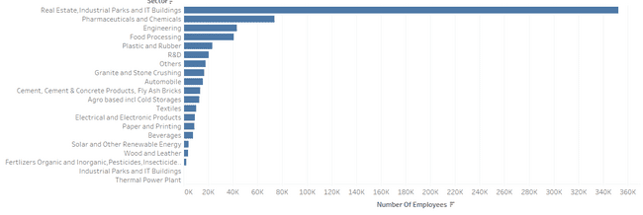
5. Real Estate, Industrial Parks and IT Buildings has the highest employment rate

Slide 49
Recommendations:
1. Promote the sales of Electric vehicles

Slide 50
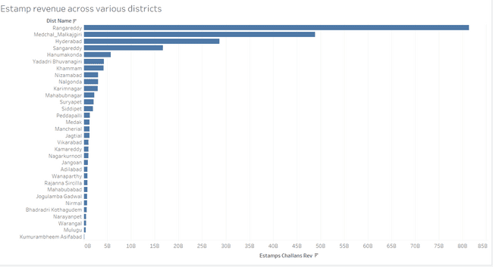
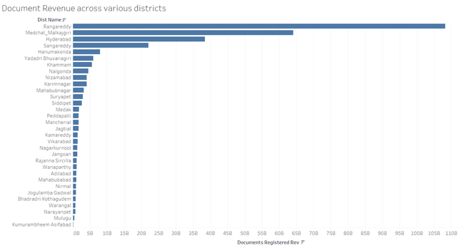
2. Kumurambheem Asifabad generates least document and estamp revenue

Slide 51
3. Least investment is done in Thermal power plant

Slide 52
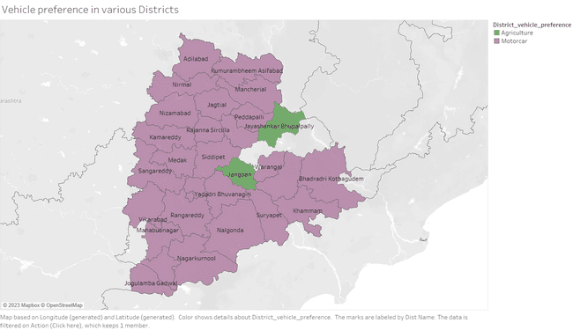
4. More Agriculture Vehicles

Slide 53
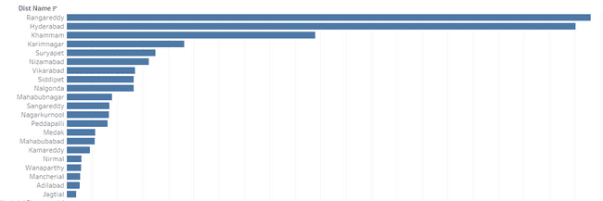
5. Jagtial has the least number of industrial units

Slide 54
THANK YOU

